Slide 1

Udemy Courses Presentation
EDA and Data Visualization

Slide 2
General Info on Udemy:

Slide 3

Udemy, Inc. is an American a massive online open course (MOOC) platform that offers both free and paid courses aimed at professional adults and students.
It was founded in May 2010 by Eren Bali, Gagan Biyani, and Oktay Caglar.
Anybody can create a course, a business model by which allowed Udemy to have hundreds of thousands of courses.
As of Jan 2020, the platform has more than 35 million students and 57,000 instructors teaching courses in over 65 languages.

Slide 4
About Dataset:

Slide 5

The project contains dataset with entire details of various courses from sizeable subjects from the year 2011 to 2017 available on Udemy platform.
this dataset contains 12 columns and 3.682 records of courses from 4 subjects (Business Finance, Graphic Design, Musical Instruments and Web Design) taken from Udemy.
For more information about dataset :
https://www.kaggle.com/andrewmvd/udemy-courses

Slide 6
Analysis and Visualization:

Slide 7
At the beginning there were 12 columns and 3678 rows present on the dataset with no null values but there was 6 duplicated rows so we drop them and also drop the courses that has not lectures.
There was 2 unneeded columns ( 'course_id' and 'url') so we drop them.
Then we change the 'published_timestamp' column to correct Datatype and add a year column.
Then we start the EDA processes with 3672 rows and 11 columns.

Slide 8
Number of Paid and Free courses:

Slide 9
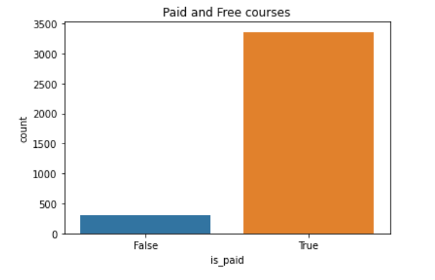
1- Count Plot:
Paid VS Free courses

Slide 10
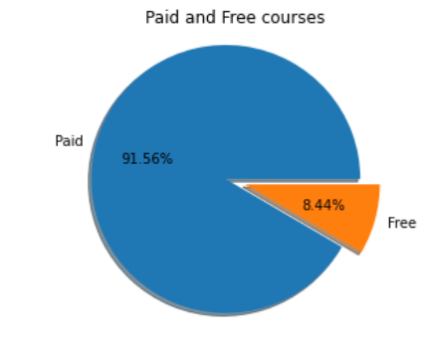
2- Pie Plot:
most of the courses are paid.

Slide 11
Relation between paid courses and number of subscribers :

Slide 12
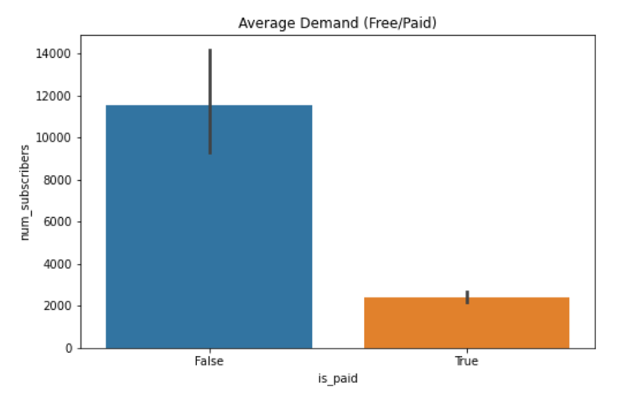
Free courses are in demand more than paid courses.

Slide 13
Number of courses in each subject:

Slide 14
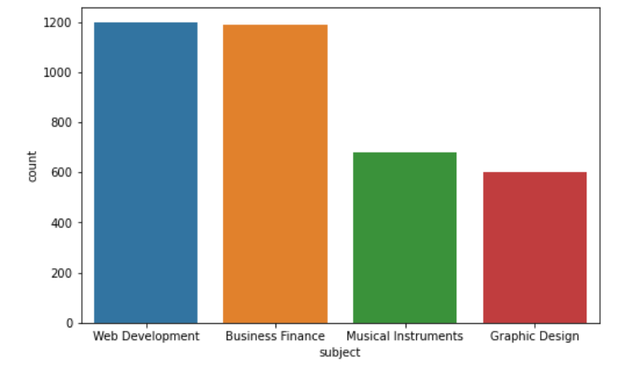
1- Count Plot:

Slide 15
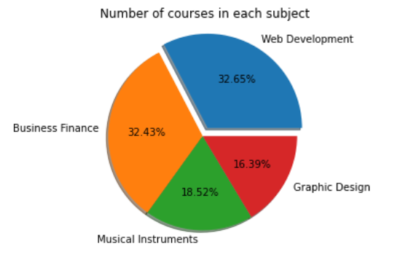
2- Pie Plot:
'Web Development' and 'Business Finance' have the bigger number of courses and they are almost equal.

Slide 16
Which subject has the max number of Subscribers?:

Slide 17
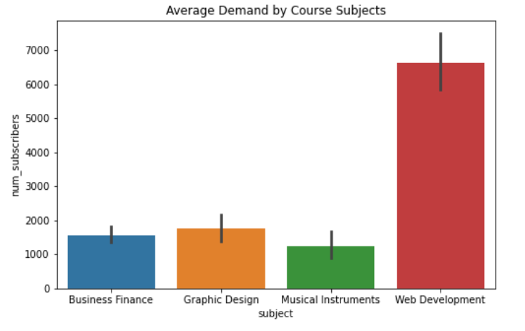

Slide 18
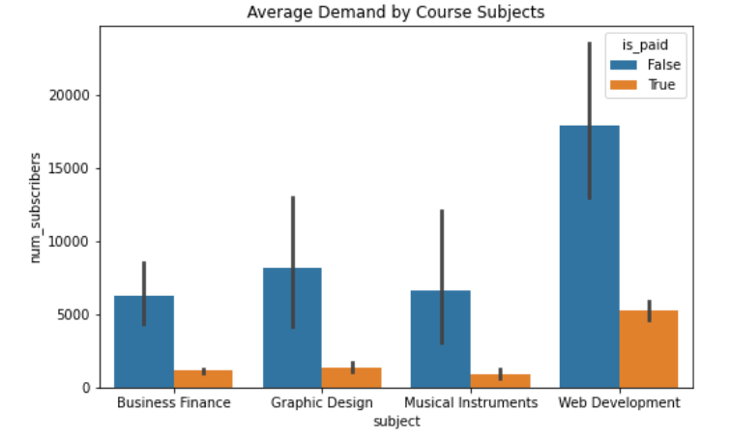
web development and Free courses are the most popular to the subscribers.

Slide 19
Number of courses in each level:

Slide 20
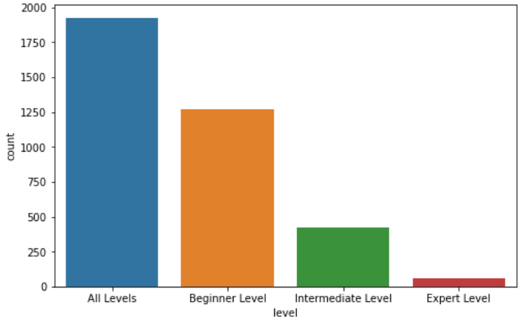
1- Count Plot:

Slide 21
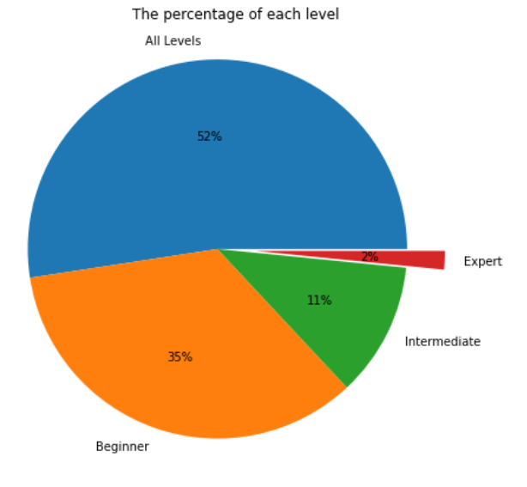
2- Pie Plot:
Most of courses are in all levels and only few courses are in expert level.

Slide 22
Relation between price and number of subscribers:

Slide 23
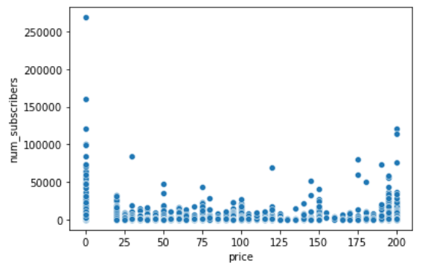
The most popular courses tend to be either free or very expensive.

Slide 24
Which course duration and number of lectures does subscribers prefer?

Slide 25
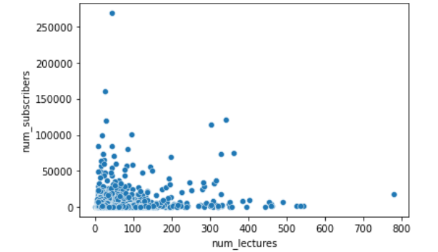
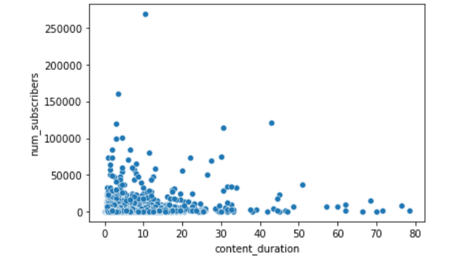
Plots with the number of lectures and content duration show that most popular courses are shorter, and have fewer number of content hours.

Slide 26
Which level of subjects are among highly priced than others?

Slide 27
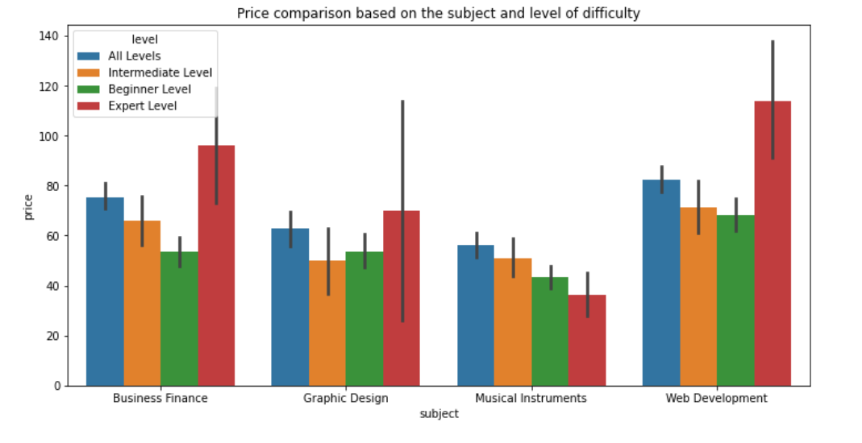
On most of the subjects Expert level of courses are seemed to be highly priced compared to other level (other than for Musical Instruments).

Slide 28
Total price of courses over the years:

Slide 29
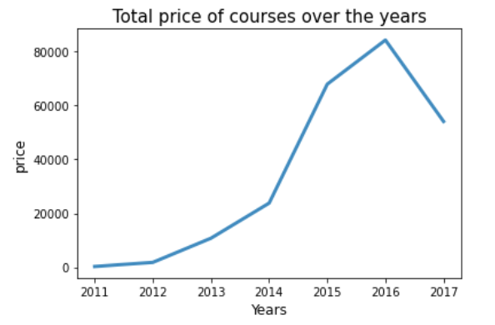

Slide 30
What is the most 5 courses that have high subscribers?

Slide 31
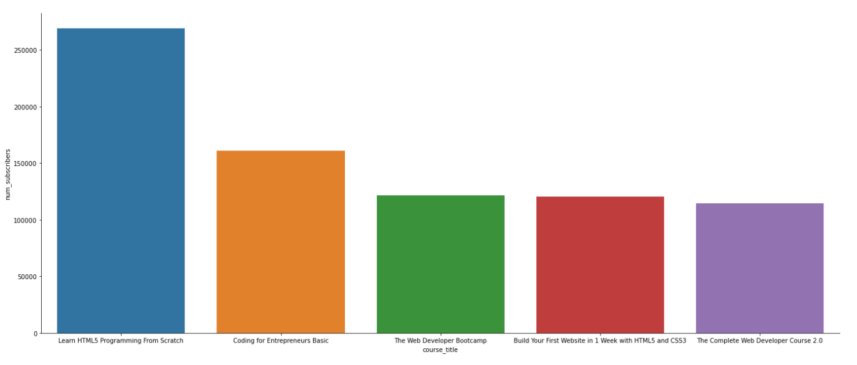

Slide 32
Most 5 courses that have high reviews?

Slide 33
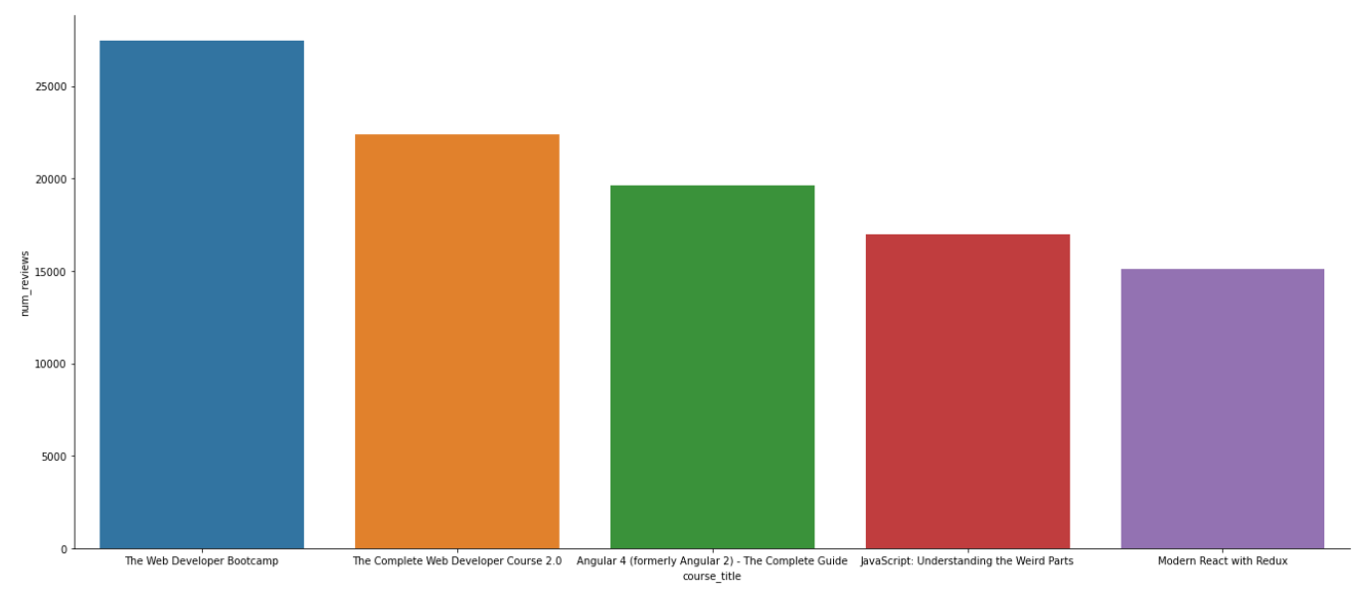

Slide 34
Top 20 courses that have high price

Slide 35
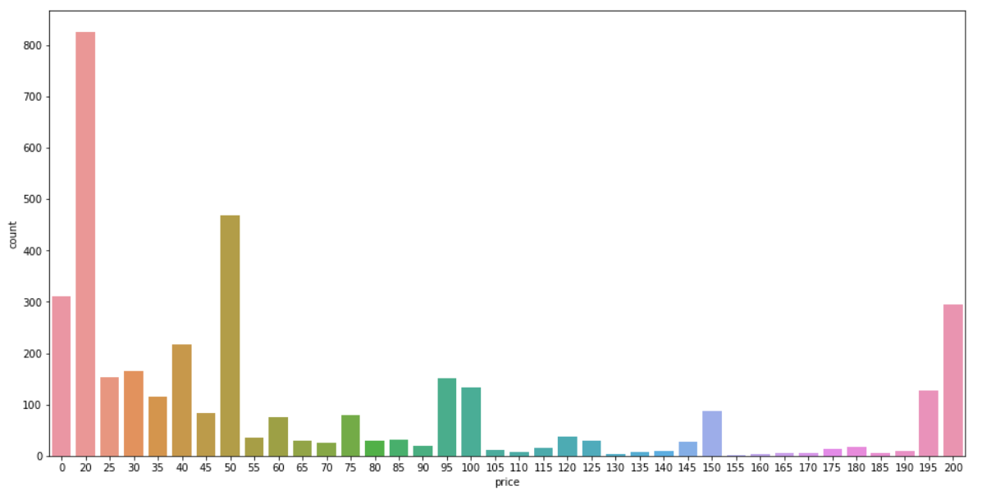
count of courses price:
We can see that 300 courses have the max number of prices(200) so the top 20 courses will have the same price.

Slide 36
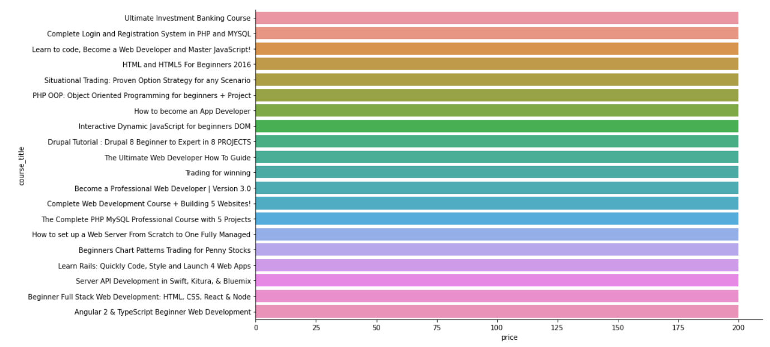

Slide 37
Top 10 courses that have high num_lectures

Slide 38
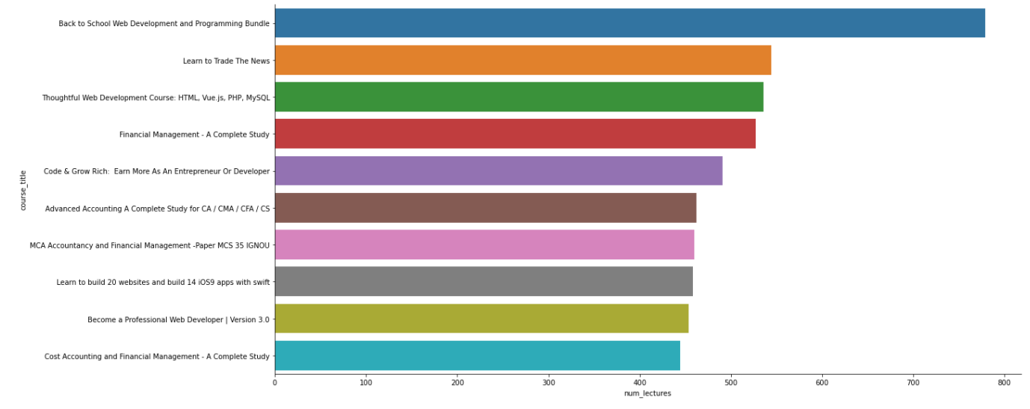

Slide 39
Top 10 courses that have longest duration

Slide 40
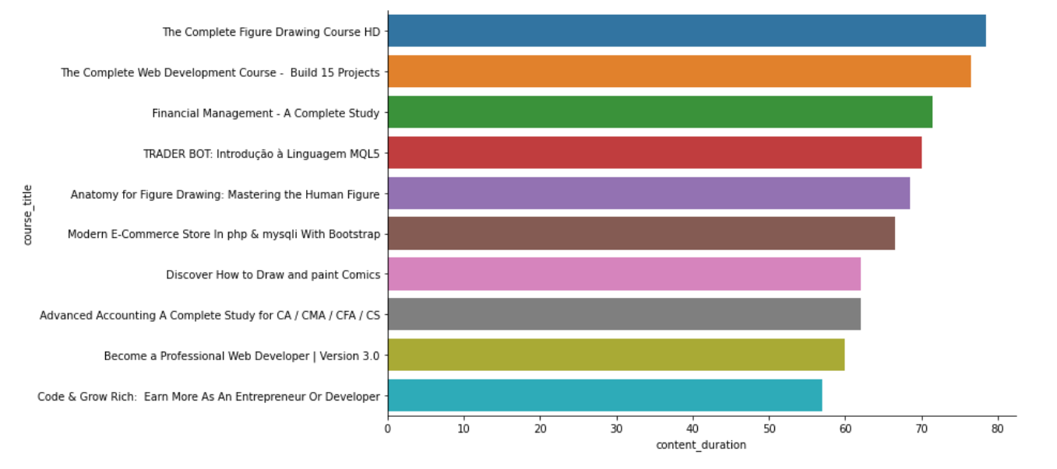

Slide 41



Thank You
Made By:
Alaa Hussien
Ahmed El Sadawy
Alaa Ayman

